Slide 1






AN ANALYSIS OF
Mental Health in the Tech Industry
A 2014 dataset dive by Team 1 - Taylor Bauer

Slide 2
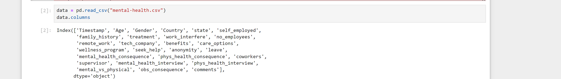
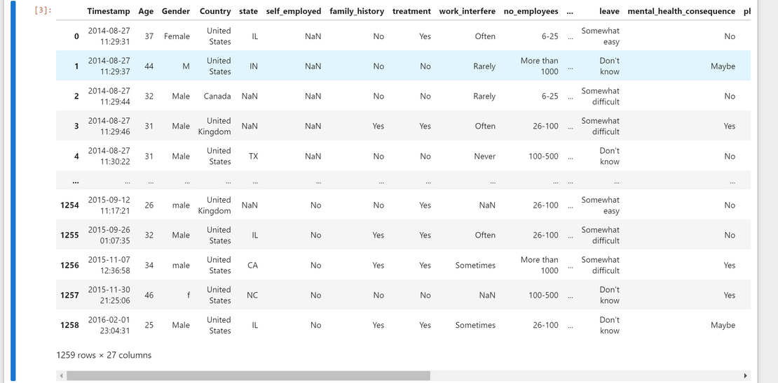
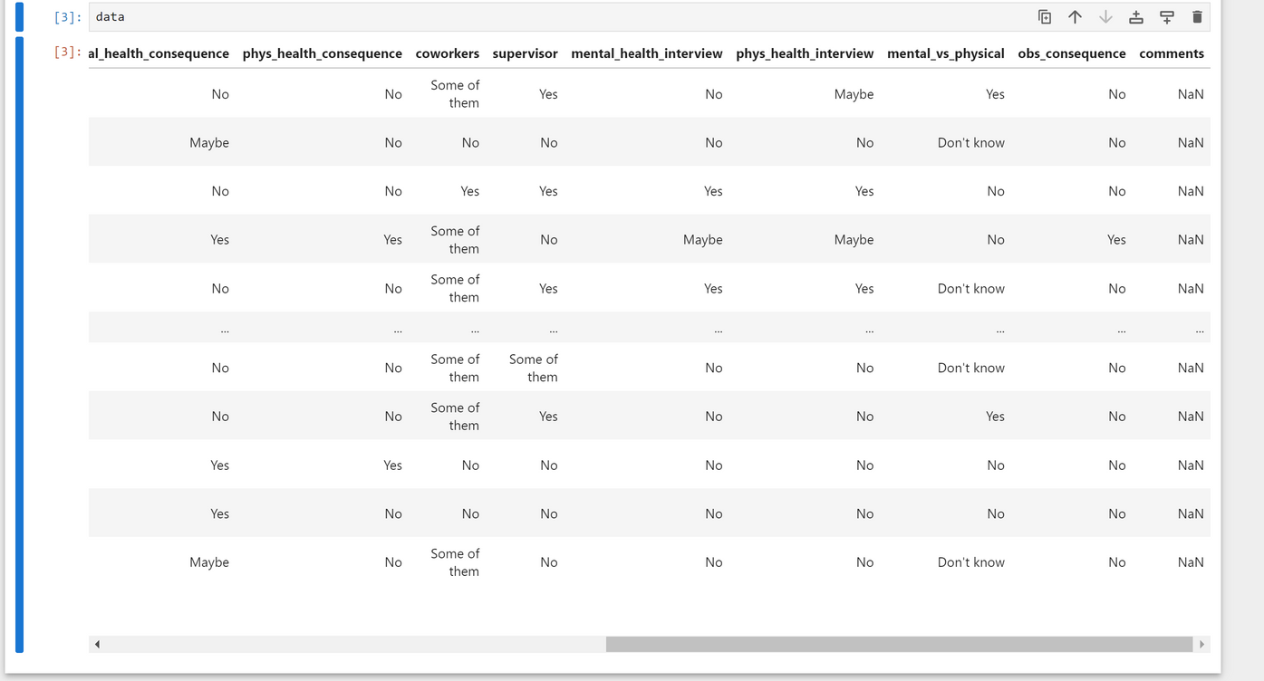
The Data: Mental Health in Tech Survey - 2014
Origin:
Kaggle
Demographic Information:
Age, Gender, State, Country, Employment Status
Mental Health Information:
Treatment sought for mental health, family history, work interference
Workplace Details:
Tech company affiliation, benefits provided by employer, awareness of mental health care options, and more.
Attitudes and Perceptions:
Willingness to discuss mental health with coworkers, supervisors, job interviews, and comparison to attitudes about physical health
Several other data features

Slide 3

State-Wise
Question: Are there specific states where technology employees more likely to seek mental health treatment?
Impact of Remote Work
Question: Does remote work influence tech employees seeking mental health treatment?
Awareness and Comfortability
Question: Are there differences in sought mental health treatment based on awareness of resources and comfort level of discussing mental health issues with coworkers or supervisors?
Gender
Question: Does gender have an impact on seeking mental health treatment?
Data Queries
WHAT VARIABLES CONTRIBUTE TO SOUGHT MENTAL HEALTH TREATMENT?

Slide 4

Benefits!
Inclusive, assistive, and increased workplace for employees.
Improving remote work conditions and practices.
Supporting employee well-being to improve productivity.
Identifying regional disparities.
Mental Health Awareness in the workplace.

Slide 5

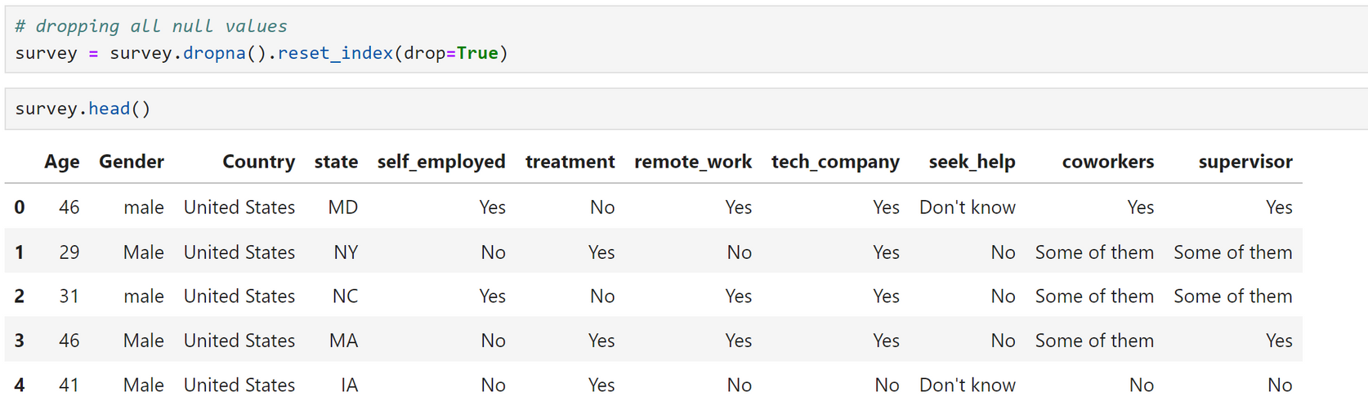
Data Preparation
CLEANING & ORGANIZING
Several of columns were dropped due to the analysis focusing on the following variables:
treatment (target)
age
gender
country (US)
state
remote_work
seek_help
coworkers
supervisors
tech_company (Yes)

Slide 6

Data Preparation
CLEANING & ORGANIZING
Dropped all entries with null values - to increase the quality of analysis
Focused in on analysis solely for entries in the United States of America
Concentration of company empoyees - some picked features relate to company environment
Wanted analysis to deal with companies who were primarily regarded as a “Tech Company”

Slide 7
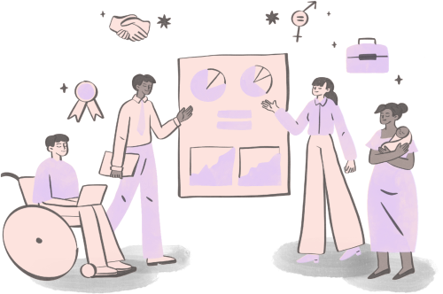
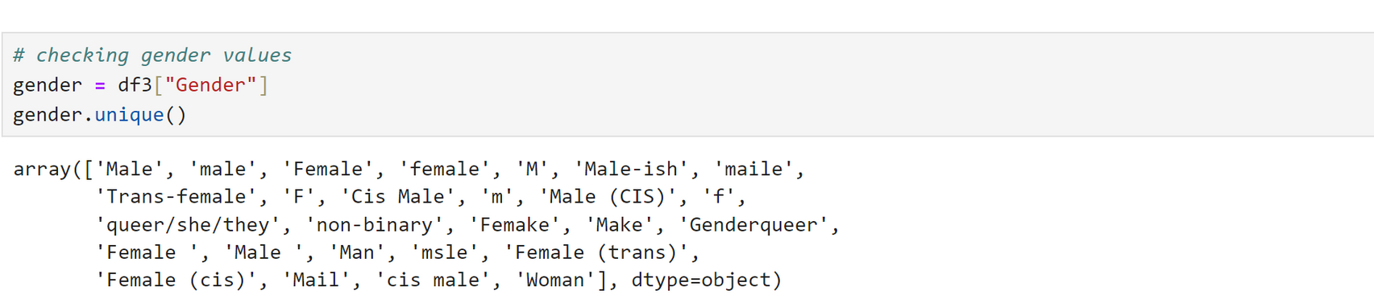
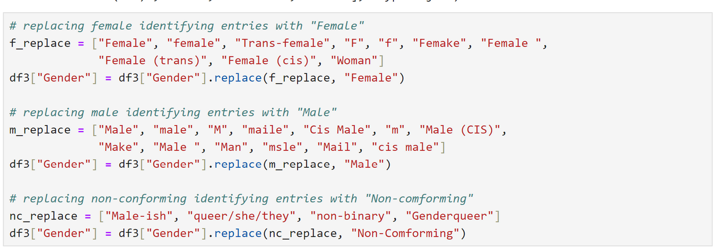
Data Preparation
CLEANING & ORGANIZING
Due to the gender survey question being free response, there were numerous different gender entries
Ultimately, I wanted to change the values to make it easier for future use
I struggled with choosing the values to categorize, because I wanted to respect participants gender identities
Decided these could possibly best fit into three categories, which would help with my future data exploration
“Female” maps to those who identified as cis-female or trans-woman
“Male” maps to entries who identify with male, as there were no trans-men entries
“Non-Conforming” maps to those who were uncertain or non-conforming to gender roles

Slide 8
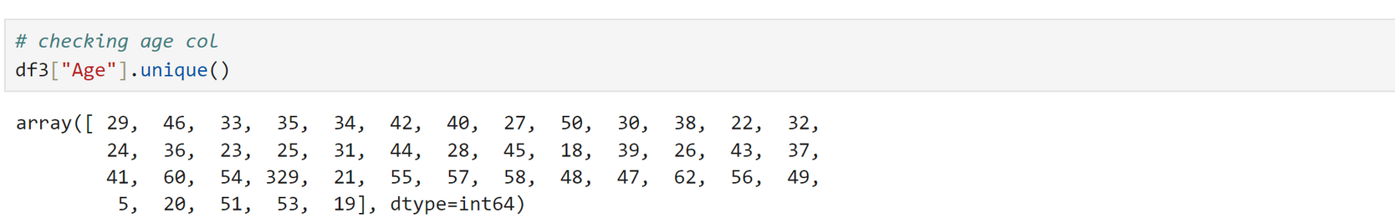
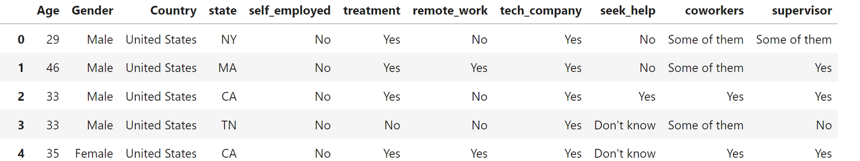
Data Preparation
CLEANING & ORGANIZING
In addition to gender, age was also a free response survey question
This can lead to typos and incorrect values in the data set
Wanted to ensure all ages were realistic so any descriptive statistics on age were not skewed
Found two outliers for the context - entries were dropped

Slide 9

Hypothesis
Remote work will have a fairly substantial impact on whether treatment is sought
Women will have sought more treatment
There will be less elder people and more young people
More supportive and comfortable atmospheres will have less sought treatment

Slide 10
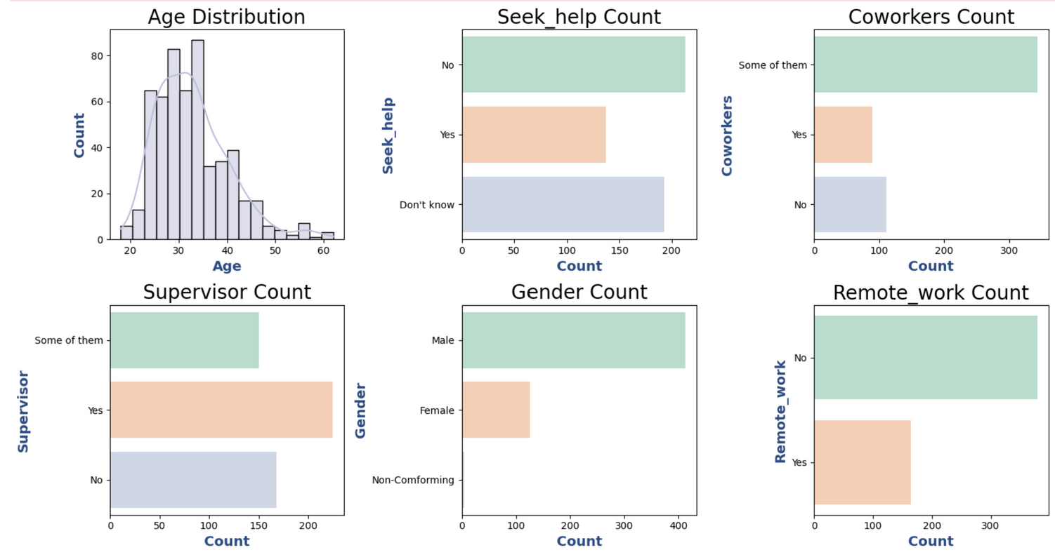
Descriptive Stats - Variable Distributions
count: 543
mean: 32.8
std: 7.53
min: 18
max: 62
Frequency Count
Yes: 137
No: 213
Don’t know: 193
Percentage:
Yes: 25.2
No: 39.2
Don’t know: 35.5
Frequency Count
Yes: 89
No: 111
Some of them: 343
Percentage:
Yes: 16.4
No: 20.4
Some of them: 63.2
Frequency Count
Yes: 225
No: 168
Some of them: 150
Percentage:
Yes: 41.4
No: 30.9
Some of them: 27.6
Frequency Count
Male: 413
Female: 126
Non-Conforming: 4
Percentage:
Male: 76.1
Female: 23.2
Non-Conforming: 0.7
Frequency Count
Yes: 164
No: 379
Percentage:
Yes: 30.2
No: 69.8

Slide 11
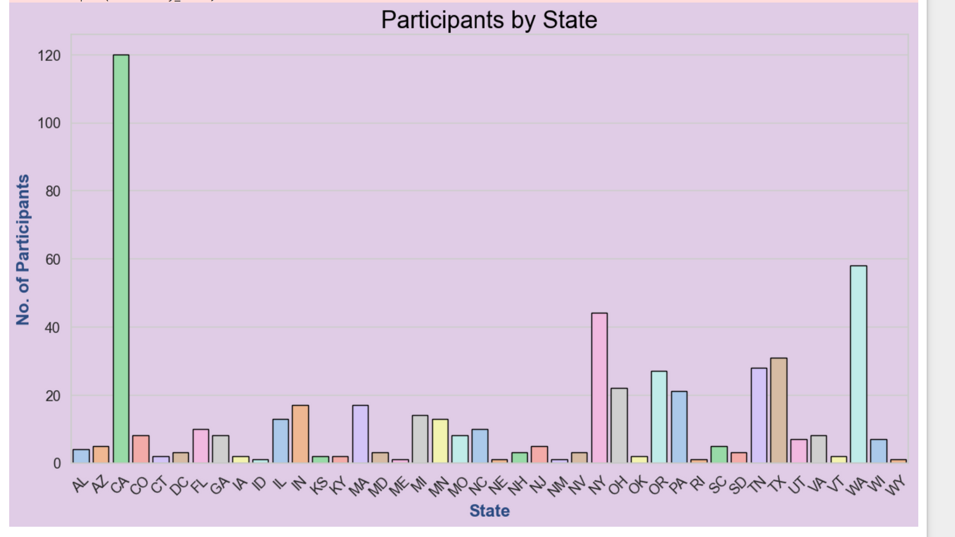
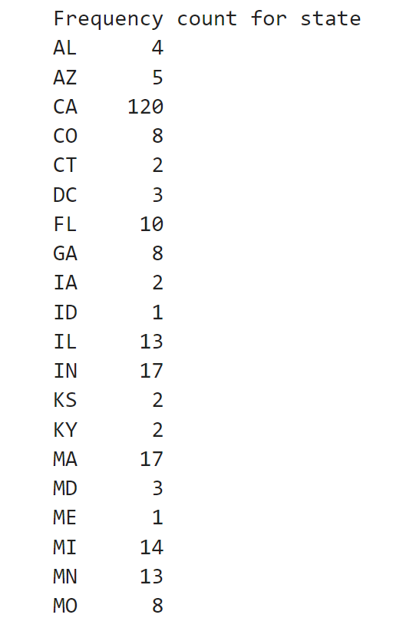
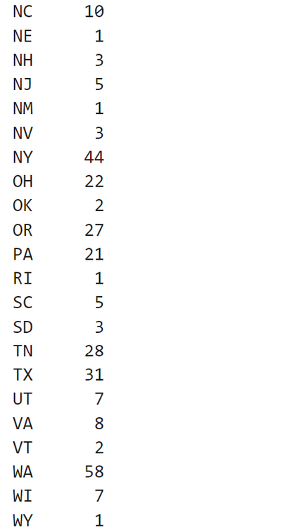

Descriptive Stats - Variable Distributions
Frequency Counts for States

Slide 12
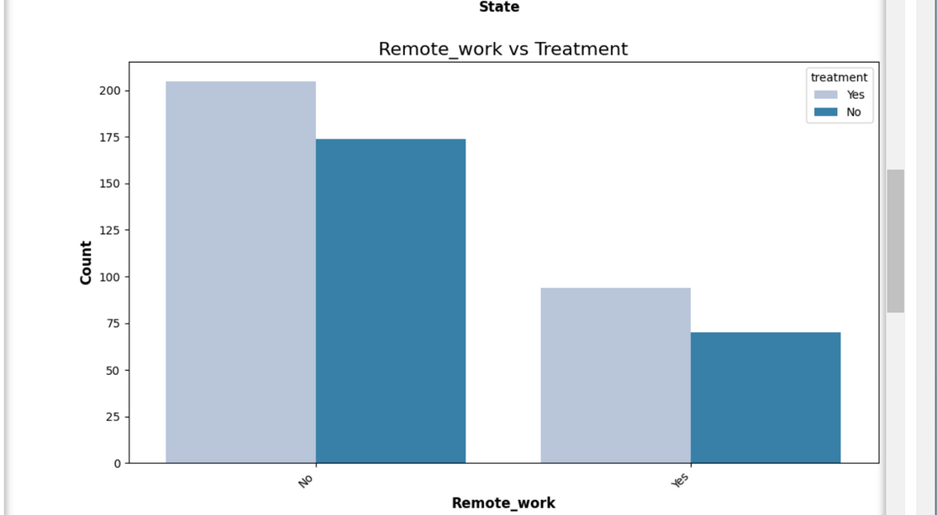
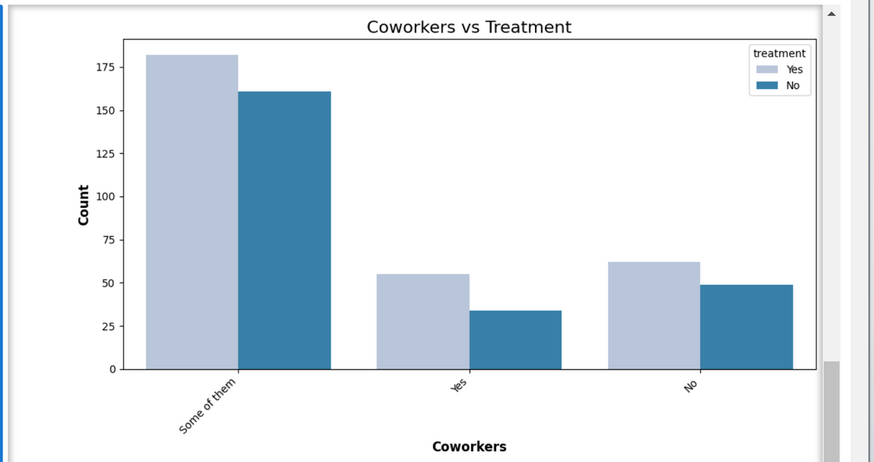
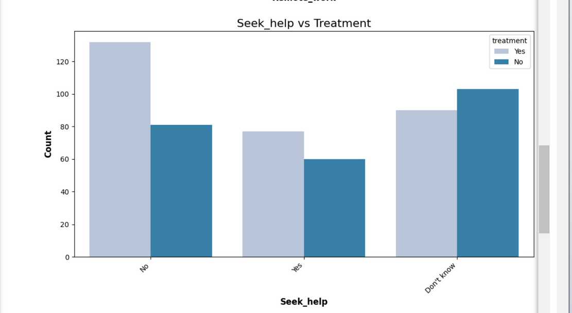
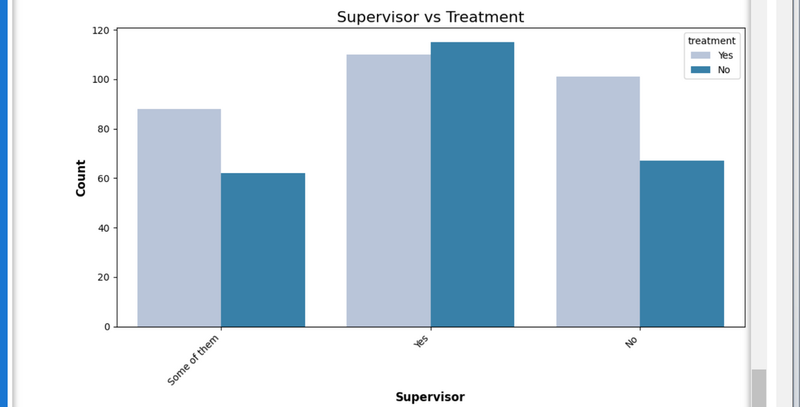
Variable Interactions

Slide 13
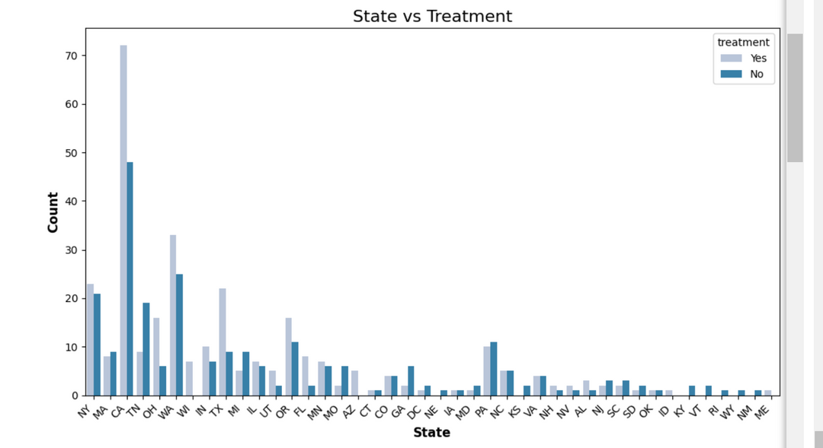
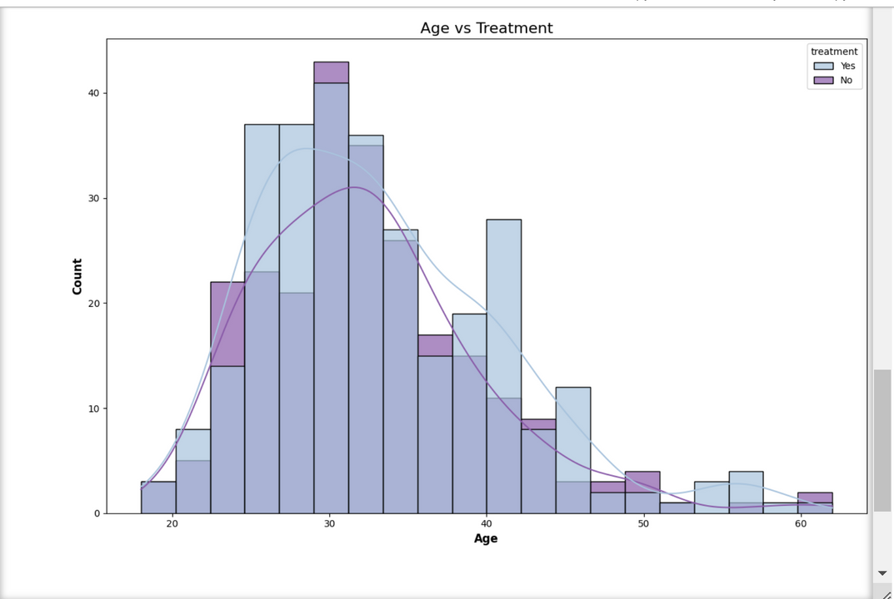
Variable Interactions
California:
Seems to have the highest number of sought treatment.
However, also has the largest number of tech workers
Mean age for treatment:
Yes (sought treatment):
33.19
No (did not seek treatment)
32.25
Not a large difference in age
Similar to mean age of entire dataset
Could be due to numerous tech workers are typically this age in industry

Slide 14
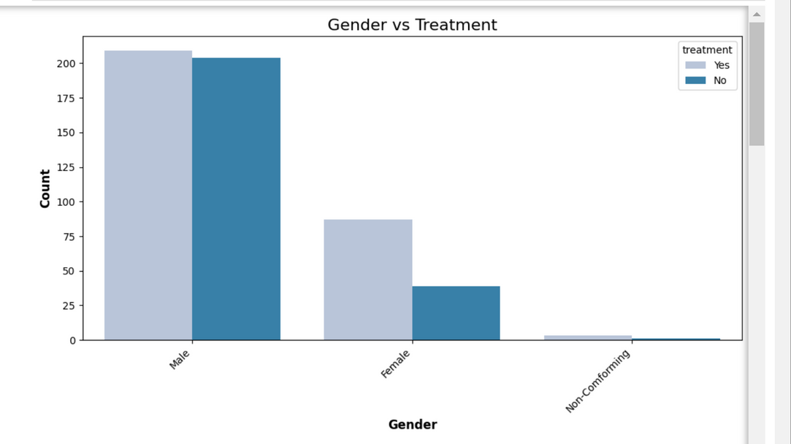

Gender | Yes | No
Female | 69.0% | 20.0%
Male | 50.6% | 44.0%
Non-Conforming | 75.0% | 1.3%
Variable Interactions
Percentages are low due to low representation of other genders
Women have seem to have sought treatment more
Men seem to border on not seeking vs seeking
Difficult to draw conclusions on non-conforming genders with such low entries

Slide 15
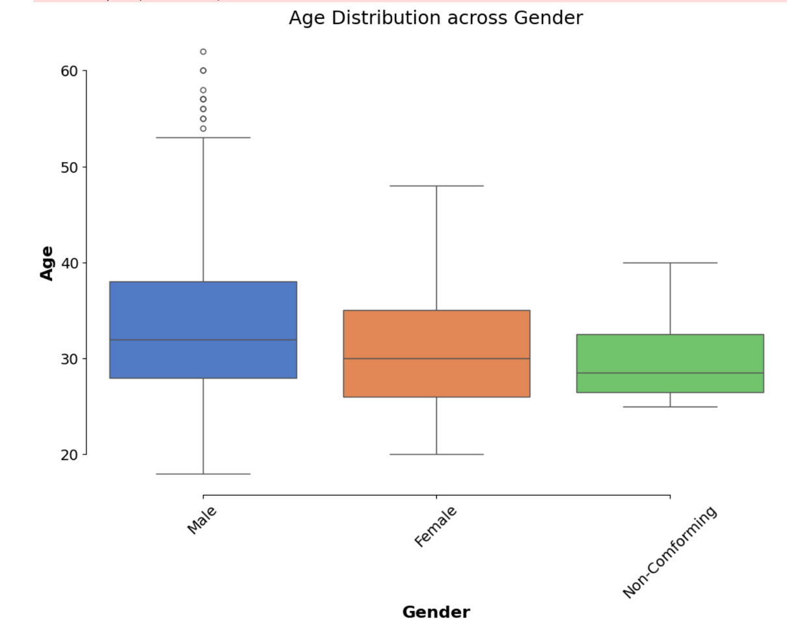

Data Anomalies
High outliers in age category - mainly men
Older men typically work more than older women
Older prominent men figures in industry
Majority of variables are categorical Chi-Squared Test
P-Values for chosen variables vs. Treatment:
Age: 0.7508
Gender: 0.4275
State: 0.5354
Remote Work: 0.2010
Coworkers: 0.8696
Supervisor: 0.9360
Seek Help: 0.0676
Notes:
Tells us if due to chance or a relationship between the cariables

Slide 16
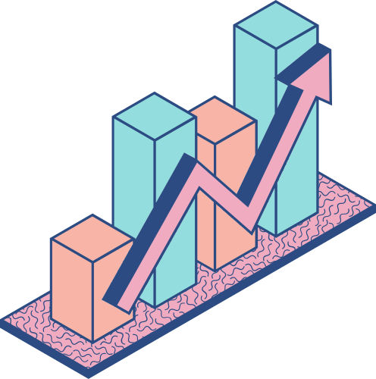
Cramer’s V
Cramer's V for Treatment versus:
Age: 0.2681
Gender: 0.1601
State: 0.3134
Remote Work: 0.0258
Seek Help: 0.1338
Coworkers: 0.0639
Supervisor: 0.1050
What this tells us:
Strength and relevance of association between variables
Closer to zero - weaker association
None of the variables are statistically significant

Slide 17
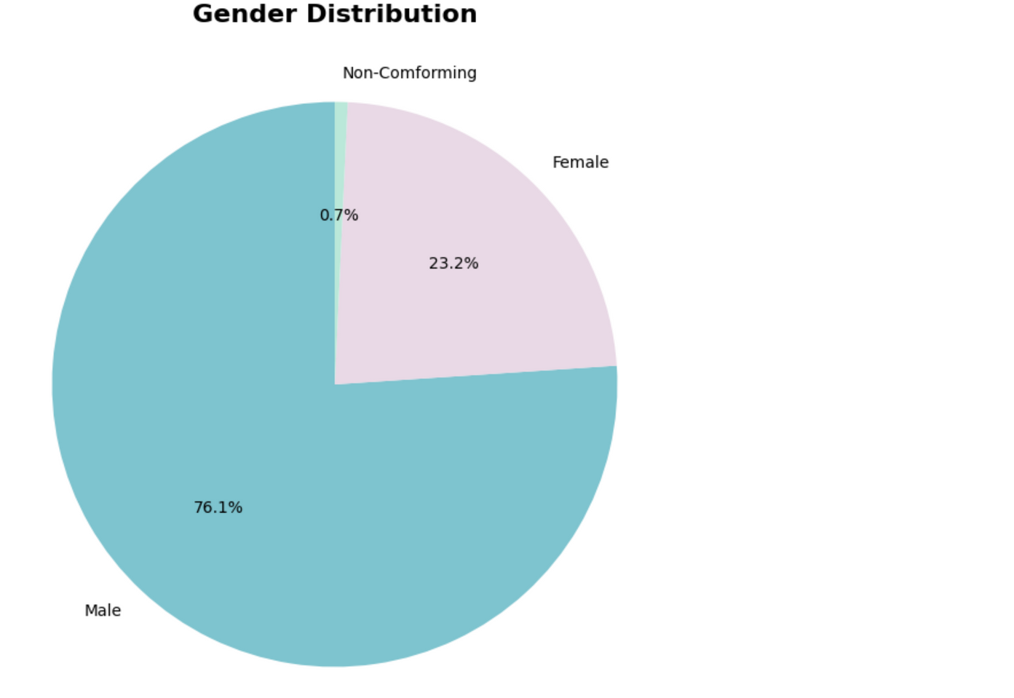
Data Anomalies
GENDER
Less significance than expected - P: 0.4275
Could be due to oversaturation of men in dataset
There were four non-conforming entries, cannot accurately represent with low numbers
Potential fixes:
Introduce more women and non-conforming genders into dataset to assist with imbalance

Slide 18
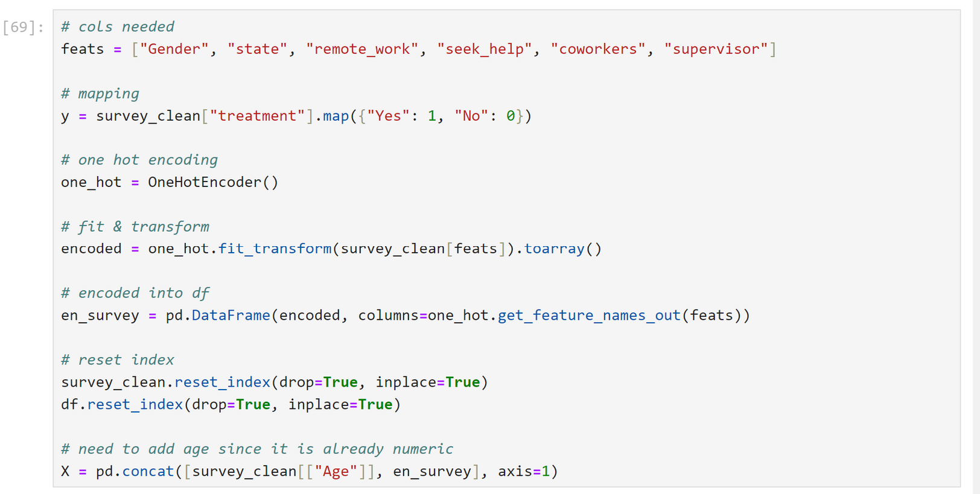

Modelling the Data One Hot & Transforming

Slide 19
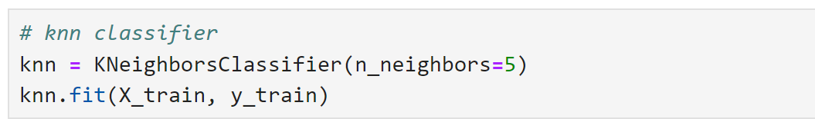
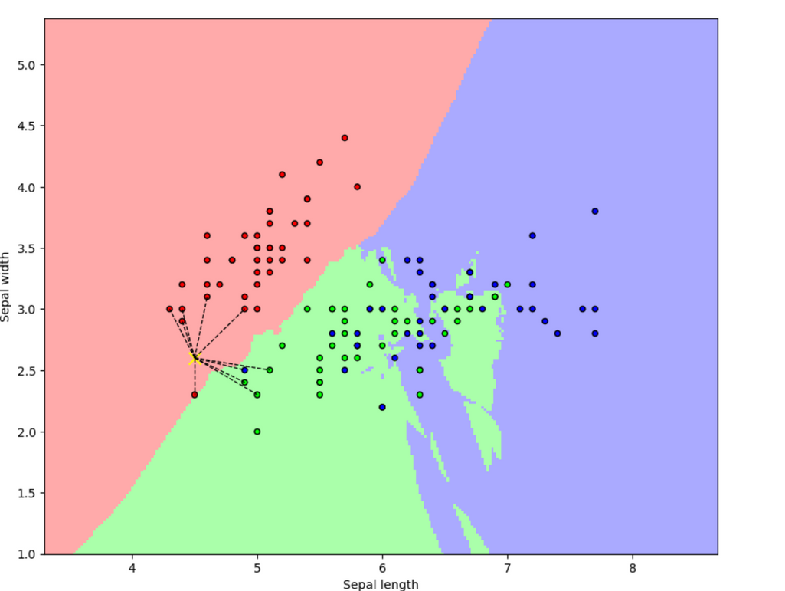
K-Nearest Neighbors
Why not other model?
KNN is easier to understand - could not find very good resources in regards to survey data and machine learning
Used for classification and a categorical target variable (which I have)
KNN does not make assumptions about linearity
Example of KNN from arise.com

Slide 20

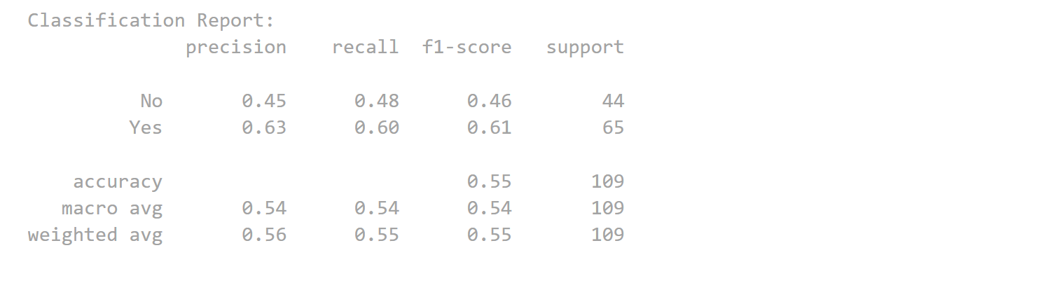
Performance
Model Accuracy: 0.55
Explanation:
Correctly predicts 55.05% of time
Not effective for predictions
Confusion Matrix
21
23
True negatives
False positive
26
39
Tends to predict yes more than no
Fixes:
Review features used (feature engineering)
Changing number of n-neighbors
Fine tuning other parameters
Performance is moderate - could try different models
False negatives
True positive

Slide 21

Thank you!

